Slide 1
MSE 5024: 高等热力学和动力学
Advanced Thermodynamics and Kinetics
Lecture 10: State of Function
Weishu Liu
Department of Materials Science and Engineering
Southern University of Science and Technology (SUSTech)
Email: liuws@sustech.edu.cn
Office: North Tower, Rm. 310

Slide 2
25. Water Phase diagram
Ref. Introduction of Thermodynamics of Materials, D. R. Gaskell, Chapter 7

Slide 3
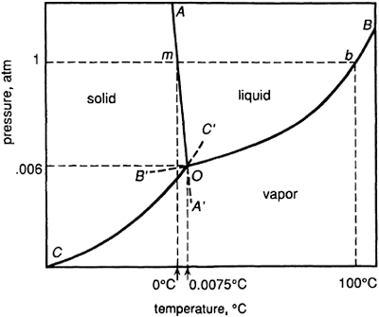



Water Phase diagram
AOA’: Solid-Liquid equilibrium line
Clapeyron eq.
BOB’: Liquid-vapor equilibrium line
Clausius-Clapeyron eq.
COC’: Solid-Vapor equilibrium line
Schematic representation of part of the phase diagram for H₂O
Clausius-Clapeyron eq.
triple point O: Solid, Liquid, Vapor are in equilibrium each other.
Metastable state: OA’, OB’ and OC’

Slide 4
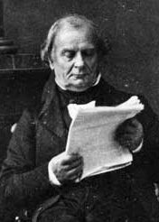
Clapeyron equation:
S-L equilibrium
The condition for the Solid-Liquid equilibrium
ΔG=G^{S}–G^{L}=0
At the equilibrium
Benoît P. É. Clapeyron
(1799-1864)
Clapeyron equation is a relationships between the variations of temperature and pressure which are required for the maintenance of equilibrium between the two phases

Slide 5
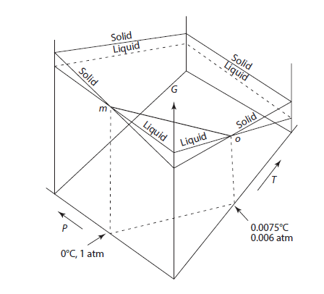
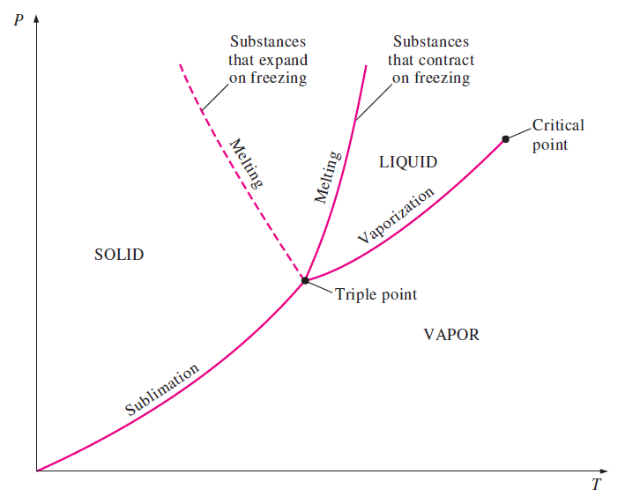
Clapeyron equation:
Solid-Liquid equilibrium
When thermal energy is added to the system
It causes the solid to melt and Δ H _{( S → L )} > 0 (endothermic).
The sign of (dP/dT)_{eq} is thus determined by the sign of Δ V _{( S → L )}
Water: V_{L} < V_{S} , Δ V _{( S → L )} <0, dP/dT <0
Normal liquid: V_{L}>V_{S} , Δ V _{( S → L )} >0, dP/dT >0
water
Normal liquid

Slide 6


Clausius-Clapeyron equation:
Vapor-condense phase equilibrium
∆V is the change in the molar volume accompanying evaporation or sublimation
∆H is the corresponding change in the molar enthalpy, i.e., the molar latent heat of evaporation or sublimation
Δ V = V ^{vapor} – V ^{condensed phase}
If it is further assumed that the vapor in equilibrium with the condensed phase behaves ideally, i.e., PV=RT
Δ V ~ V ^{vapor}
Clausius-Clapeyron equation

Slide 7



Clausius-Clapeyron equation:
Vapor-condense phase equilibrium
Clausius-Clapeyron equation
1. If ∆H is independent of temperature
i.e. C_{p}(vapor)= C_{p}(condensed phase),
and integrate
2. If ∆H is temperature dependent
i.e. C_{p}(vapor)≠C_{p}(condensed phase),

Slide 8
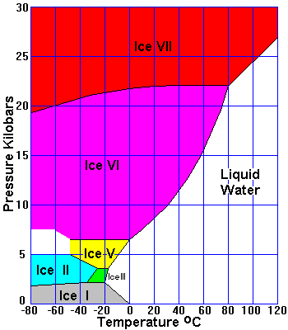
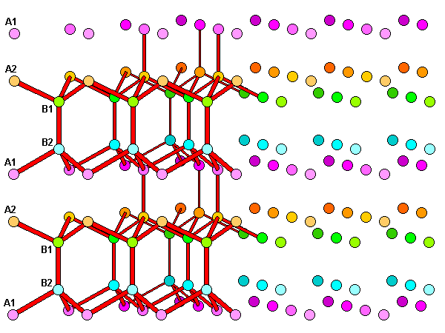
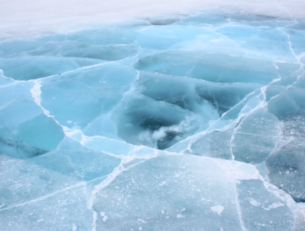
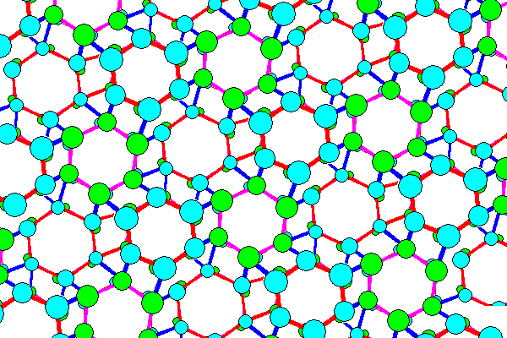
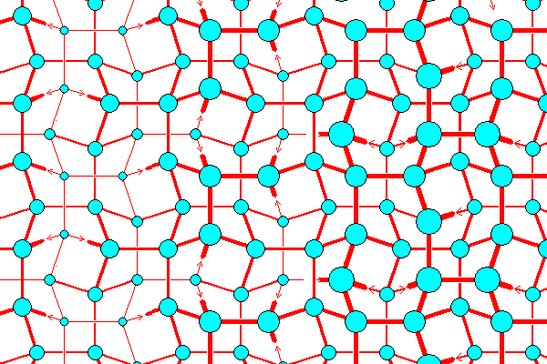
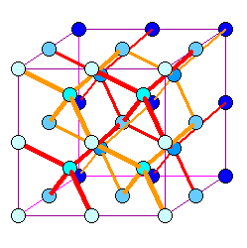
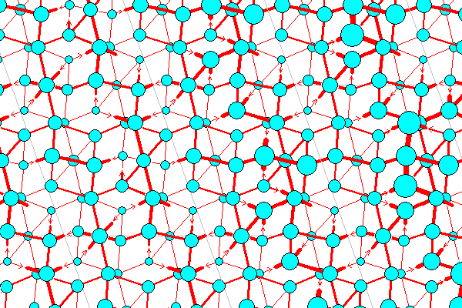
Phase diagram of H₂O at high-P
Ice(I)
Ice(II)
Ice(III)
Ice(V)
Ice(VII)
https://www.uwgb.edu/dutchs/Petrology/Ice%20Structure.HTM

Slide 9
26. High pressure
---the third dimension for material design
Acknowledgement to Prof. Shan Ming Wang, Phys. SUSTech

Slide 10
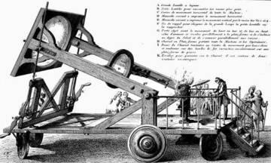
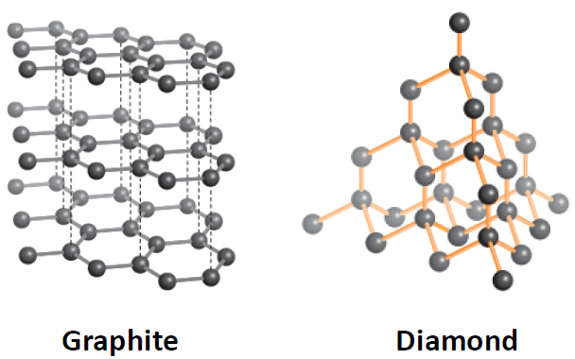
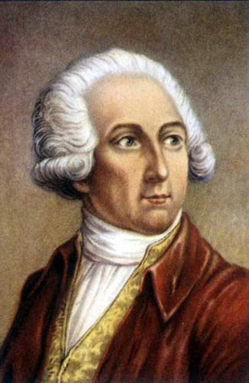
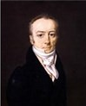
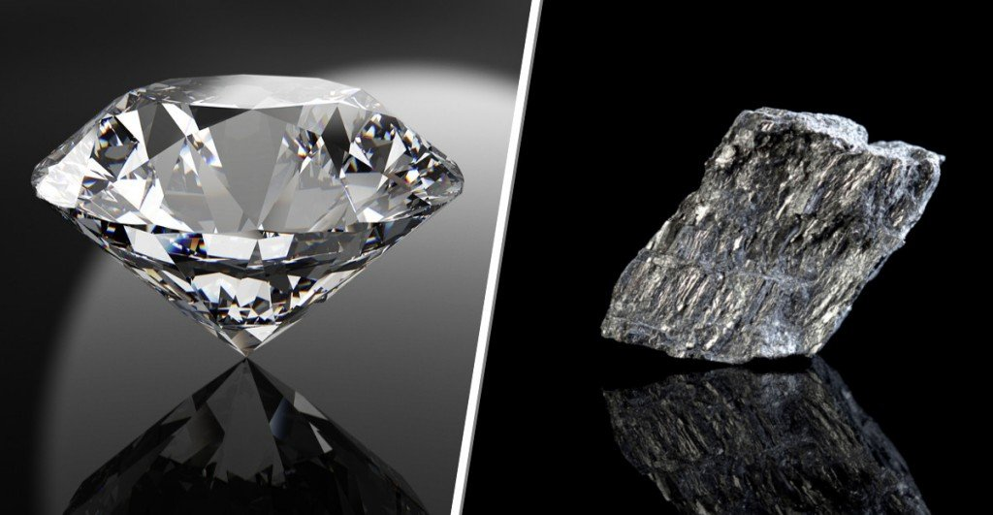
Synthetic diamonds
1772, Lavoisier
Antoine Lavoisier
1743-1794
Smithson Tennant
father of modern chemistry

Slide 11
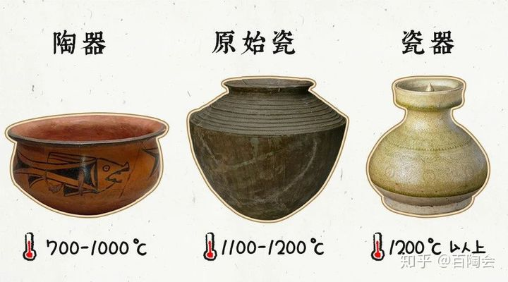
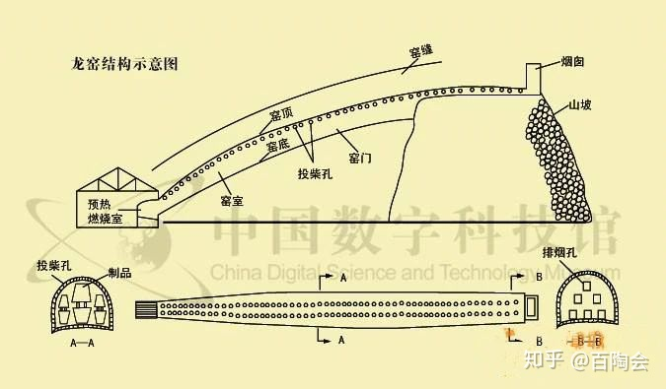
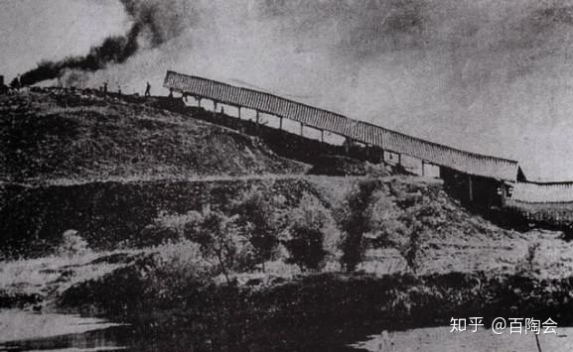
始建于明代，历代多次翻新修葺，窑道长43.4米，内底宽2.3米，高1.55米。窑身设投柴孔（俗称麟眼洞）42对，右侧有壶口（窑门）5个，燃料主要为煤、松、竹枝等，产品以罐、瓮、盆等粗陶为主，烧成温度1150℃

Slide 12
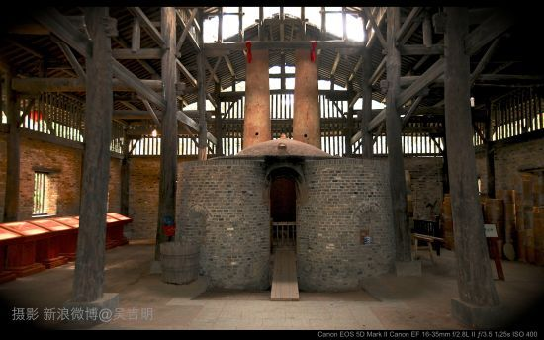
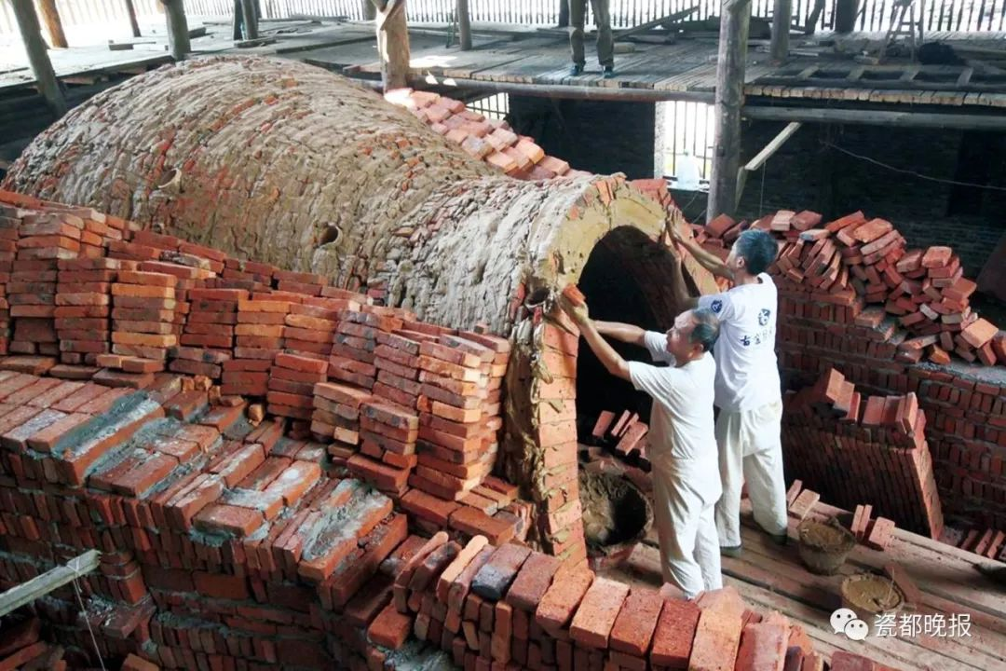

Slide 13
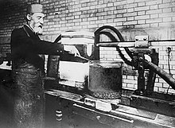
Synthetic diamonds
1893, Moissan claimed he create synthetic diamonds using an electric arc furnace
1906 Nobel Prize in Chemistry for his work in isolating fluorine from its compounds
1907, Moissan die in Paris
Henri Moissan, 1852-1907
The first synthetic diamonds are proved fake !!!

Slide 14
Calculate the pressure
to obtain the diamond from graphite at 298K
The volume change for the phase transition
For the transformation from graphite to diamond, at P=1, T=298K
Calculate the pressure at the equilibrium condition, P and T= 298
The relationship between ΔG and P

Slide 15

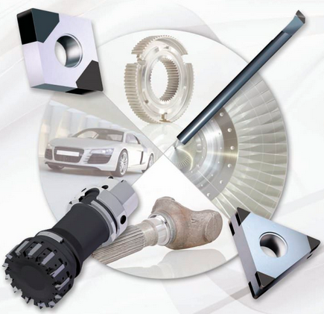

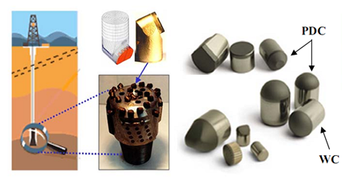
Synthetic diamonds
1941, General Electric changed the history of synthetic diamonds
HPHT (High Pressure High Temperature) process.
They placed a combination of metal and carbon into a chamber , then applied over a million pounds of pressure per square inch at a temperature of over 2,700 degrees celsius! The process took about 20 minutes

Slide 16
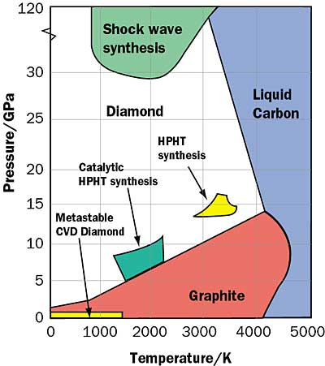
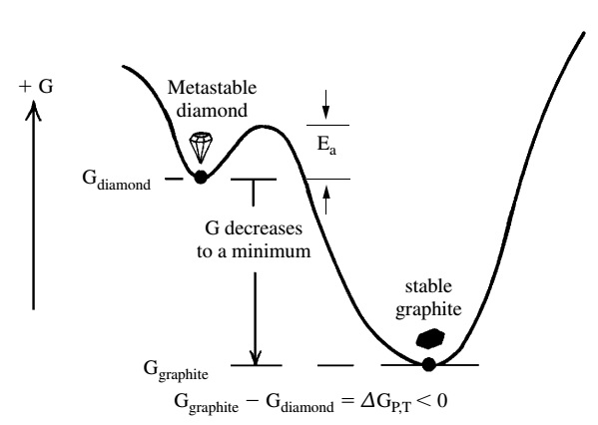
Phase diagram of carbon
金刚石
石墨
The potential barrier prevent the phase transition from diamond to the graphite
This is why we can’t synthesize diamond if no high pressure.

Slide 17
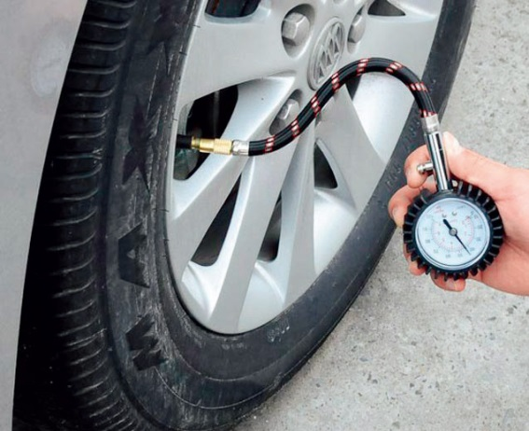
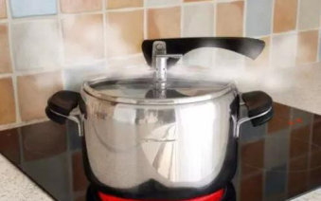
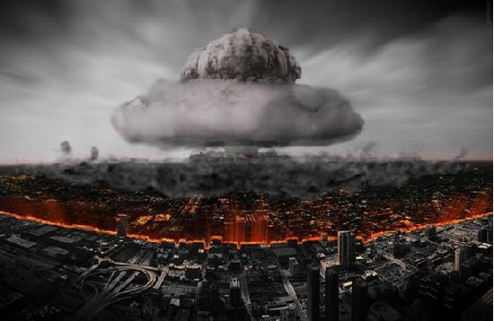
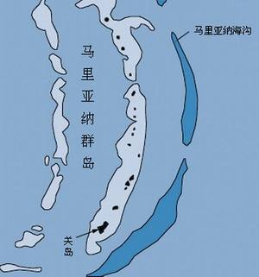
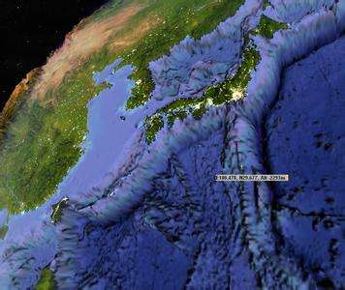
Pressure
1 GPa = 10⁹ N/m² = 10⁴ bar
1 atmospheric pressure= 1 bar
~2.5 atm（250MPa)
~1.2 – 2.0 atm
高温高压
Deepest Sea Valley：1100 atm Mariana Valley (11034 m)
~10¹¹ atm. (100 bill. atm），~10⁶ ºC
致谢：物理系 王善民

Slide 18
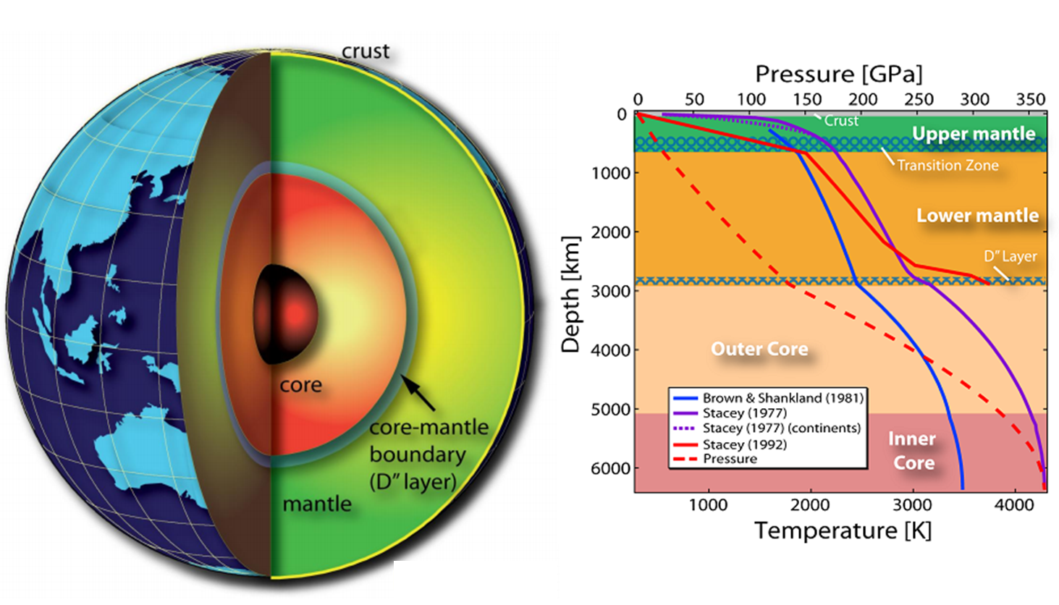
Pressure in our earth
致谢：物理系 王善民

Slide 19
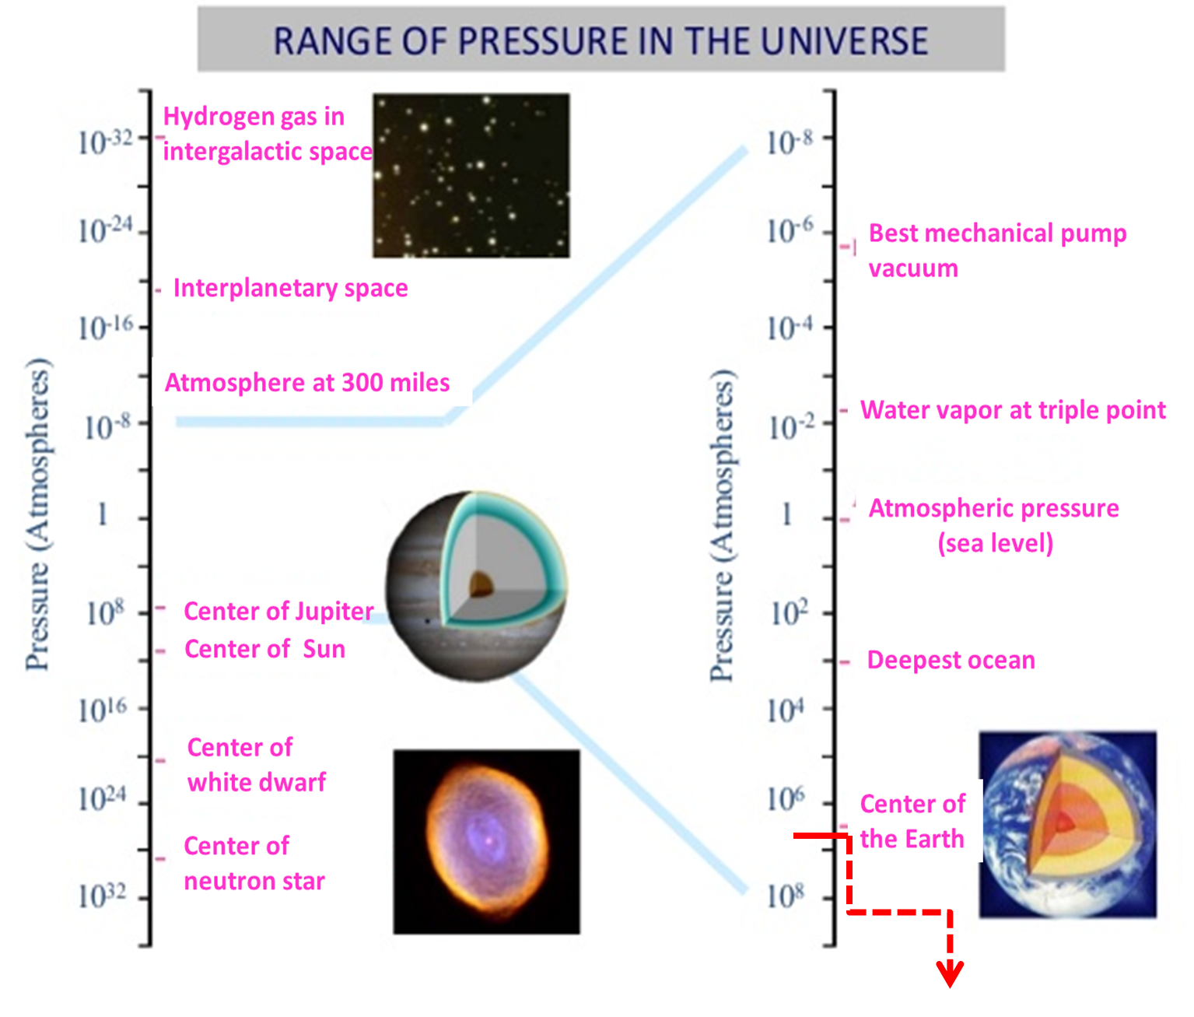
Pressure
1 GPa ≈ 10k atm.
Lab available pressure: >1000 GPa (2017).
致谢：物理系 王善民
Notes:
2010年， 研究小组利用美国布鲁克海文国家实验室的RHIC让接近光速运动的金离子进行对撞，夸克和胶子形成了高温、高密度的零黏性“完全液体”，即为夸克—胶子等离子体。通过计算后，研究人员确认撞击形成的超高温夸克—胶子等离子体“汤”温度达到4万亿摄氏度，这也是到目前为止在实验室中产生的最高温度。

Slide 20
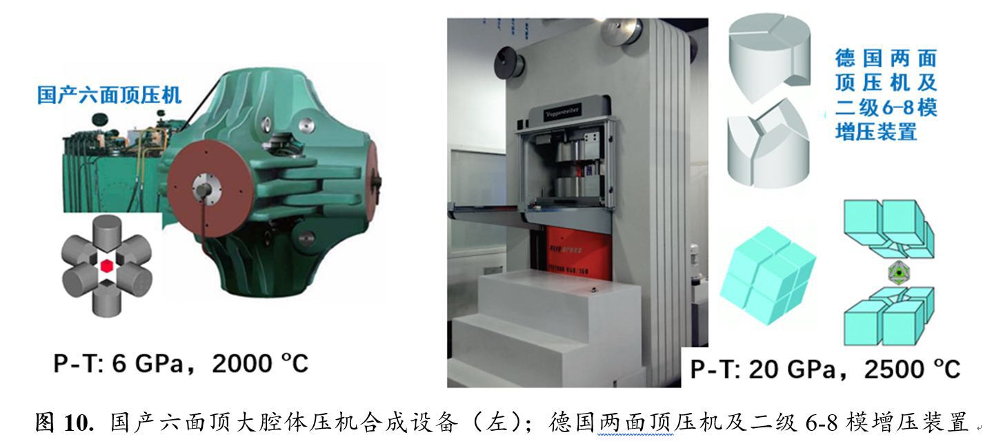
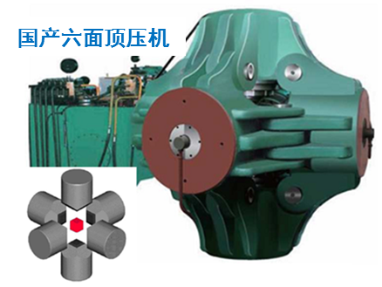
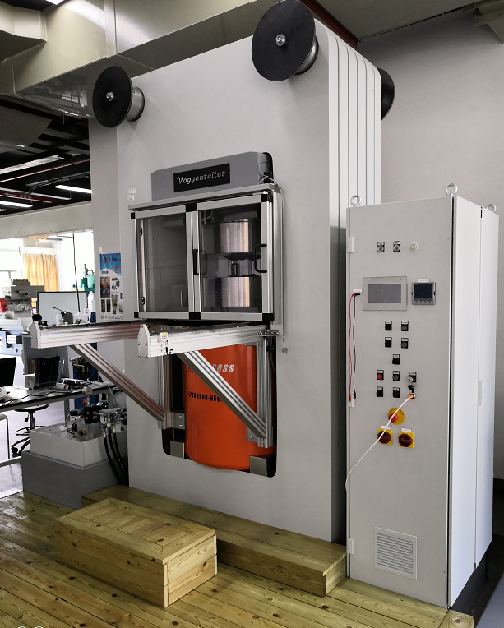
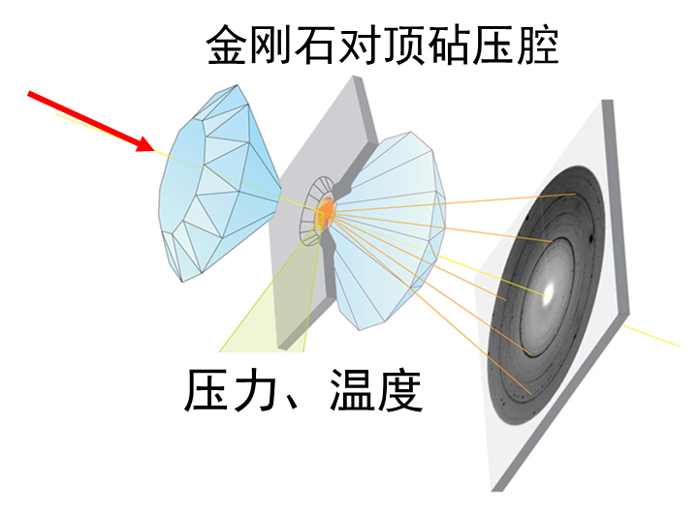
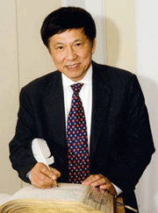
Pressure in the lab
P-T: 7 GPa, 3000 K, 厘米级腔体
P-T: 20 GPa, 2700 K, 毫米级腔体
XRD, IR, Raman…
P-T: >100 GPa, 1.5 - 4000 K
1976年，与P.M.Bell合作改进的金刚石压腔可达100GPa，第一次观察到金刚石损坏的新形式－塑性流动，
1978年，提高到173GPa，即相当于地球外核的压力。
1986年，与徐济安、P.M.Bell合作创造了550GPa的世界最高静压力的纪录（已超过地心的压力）

Slide 21
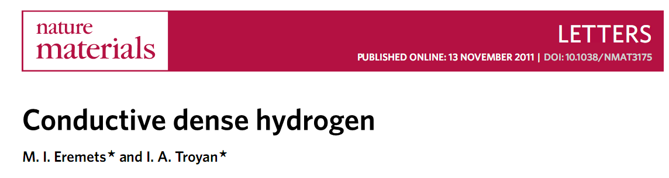
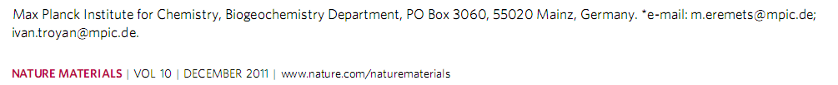
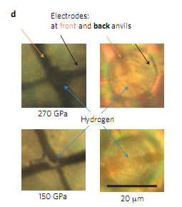
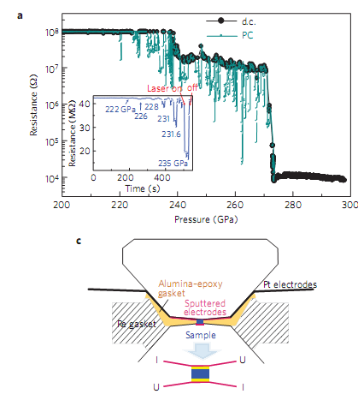

Slide 22
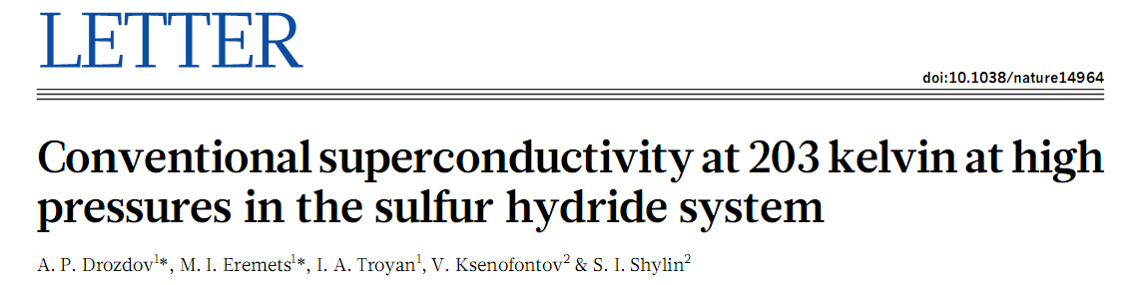
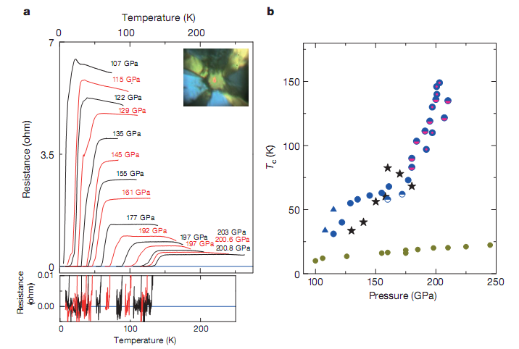
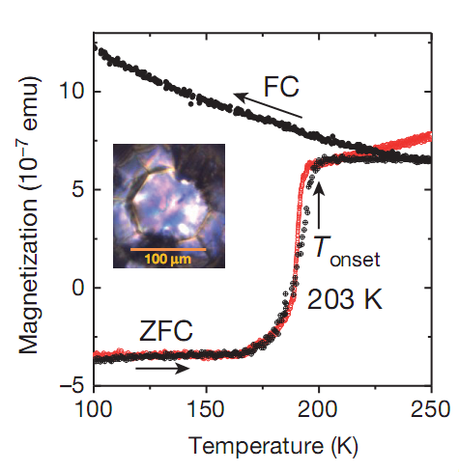

Slide 23
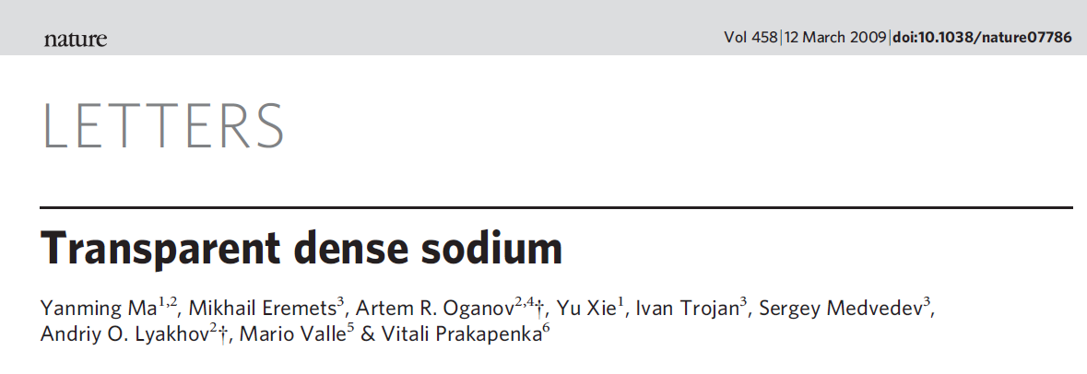
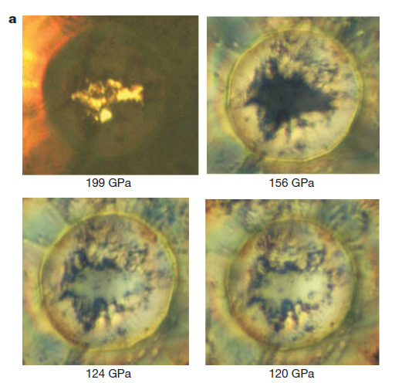

Slide 24
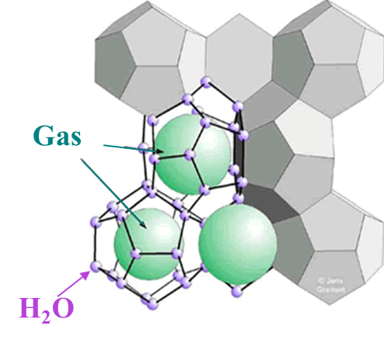
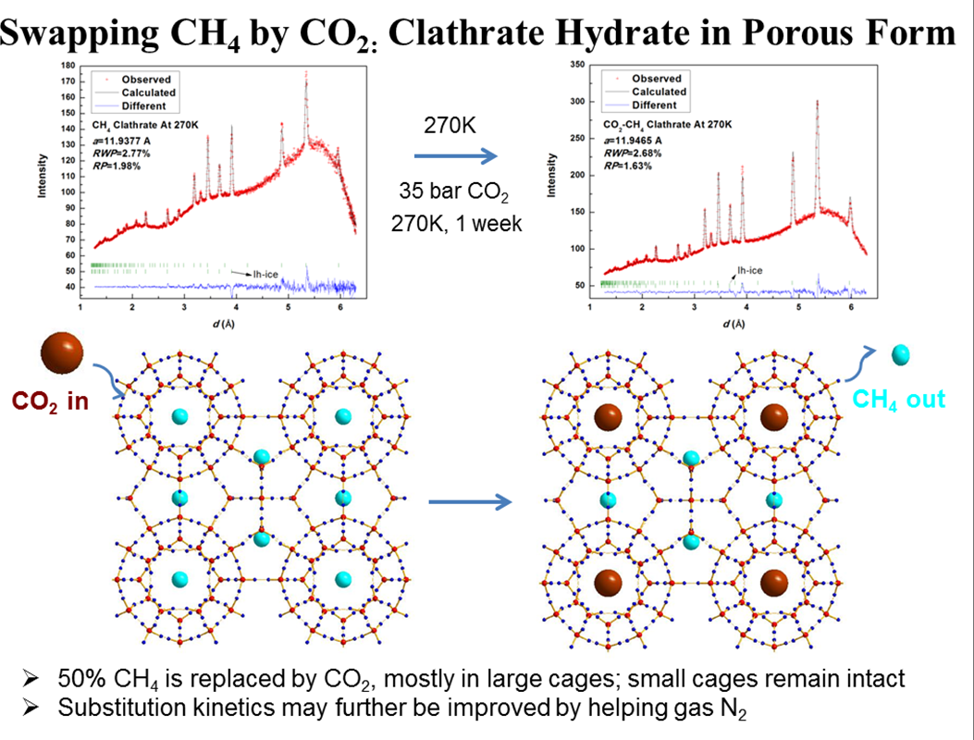
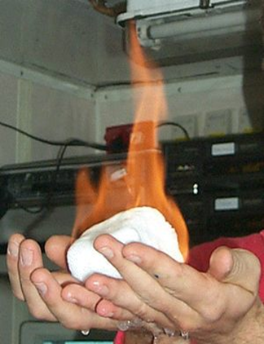
Gas clathrate hydrate
致谢：物理系 王善民

Slide 25
27. The equation of state for real gas
Ref. Introduction of Thermodynamics of Materials, D. R. Gaskell, Chapter 8

Slide 26



Equations of State
For idea gases
Two assumption for idea gas
1). The volume of the molecular is negligible
2). The attractive and repulsive for are negligible
Johannes Diderik van der Waals
Dutch, physicist
1910, Nobel Prize
For real gases
Prize motivation: "for his work on the equation of state for gases and liquids"

Slide 27





Equations of State for the non idea gas
Comparison of Z factor for various gas
Compressibility factor
The deviation of a gas from idea gas behavior in greatest in the vicinity of the critical point

Slide 28


van der Waals equation of gas
Idea gas : no volume & no interaction
Real gas: finite volume & interaction
1. Volume modification
2. Pressure modification
* Only consider the repulsive force
Internal pressure P_{i}
van der Waals equation:

Slide 29



van der Waals equation
David Keffer, Univ. of Tennessee

Slide 30
van der Waals equation
van der Waals equation for 1 mol gas:
van der Waals equation for n mol gas:
van der Waals equation for gas-i of a mixture
Notes:
15级杨小炜指出

Slide 31

Critical Point
There are minimum and maximum points
Increasing T, two points approach each other
At critical T, two points coincide and produce a horizontal in flexion

Slide 32

Critical Point
The critical point:
Normalized parameters:

Slide 33
Law of corresponding state
For a given gas
it has one critical point and there characterized parameter, P_{cr,} T_{cr,} v_{cr}
Normalized parameters: P_{R}, T_{R}, v_{R}
Van der Waals reduced equation of state
Law of corresponding states:
all gases obey the same equation of the state when expressed in terms of the reduced variables
OQ: for a 2D gas, or 1D gas?

Slide 34
https://arxiv.org/pdf/1106.1273
How their Van der Waals reduced equation of state??

Slide 35

van der Waals constant

Slide 36
Nobel Lecture Note
1873, van der Waals wrote his thesis, entitled Over de Continuïteit van den Gas- en Vloeistoftoestand (On the continuity of the gas and liquid state)
1874, J. C. Maxwell, "Van der Waals on the Continuity of Gaseous and Liquid States". Nature. 10 (259): 477–480
...It will be perfectly clear that in all my studies I was quite convinced of the real existence of molecules, that I never regarded them as a figment of my imagination, nor even as mere centres of force effects. I considered them to be the actual bodies, thus what we term "body" in daily speech ought better to be called "pseudo body". It is an aggregate of bodies and empty space. We do not know the nature of a molecule consisting of a single chemical atom. It would be premature to seek to answer this question but to admit this ignorance in no way impairs the belief in its real existence. When I began my studies I had the feeling that I was almost alone in holding that view. And when, as occurred already in my 1873 treatise, I determined their number in one gram-mol, their size and the nature of their action, I was strengthened in my opinion, yet still there often arose within me the question whether in the final analysis a molecule is a figment of the imagination and the entire molecular theory too. And now I do not think it any exaggeration to state that the real existence of molecules is universally assumed by physicists. Many of those who opposed it most have ultimately been won over, and my theory may have been a contributory factor. And precisely this, I feel, is a step forward. Anyone acquainted with the writings of Boltzmann and Willard Gibbs will admit that physicists carrying great authority believe that the complex phenomena of the heat theory can only be interpreted in this way. It is a great pleasure for me that an increasing number of younger physicists find the inspiration for their work in studies and contemplations of the molecular theory..
— Johannes D. van der Waals's notes
in Nobel Lecture, The equation of state for gases and liquids (12 December 1910).

Slide 37
The van der Waals Gas
Intrinsic stable condition:
JIHGF line violated this condition!!!

Slide 38

Maxwell construction
Prof. W.S. Liu | 38

Slide 39


Maxwell construction
Lines DF and LJ represent the metastable vapor and metastable liquid states.
In the absence of nucleation of the liquid phase from the vapor phase at the state D, supersaturated vapor would exist along the line DEF.
In the absence of nucleation of the vapor phase from the liquid phase at the state L, supersaturated liquid would exist along the line LKJ.

Slide 40
Spinodal points
stable
Pressure, P
metastable
unstable
metastable
Volume, V
J and F are the spinodal point
represents the limit of metastability of the vapor and liquid

Slide 41


Maxwell construction

Slide 42
latent heat of van der Waals Gas
Latent heat of Evaporation from liquid to vapor
Maxwell equations
Latent heat of Evaporation rapidly falls to zero when the temperature approaches to T_{cr}
van der Waals Gas

Slide 43
Redlich-Kwong Equation of State (1949)
van der Waals equation
Redlich-Kwong Equation
Home work:
derive the reduced equation of state for the Pedlich-Kwong’s equation

Slide 44



Other Equations of State for the Vapor
Beattie-Bridgeman:
where
The constants a, b, c, A_{o}, Bo for various substances are found in Table 3-4.
Benedict-Webb-Rubin:

Slide 45
Viral Equations of State for the Vapor
Idea equation of state
Viral equation of state

Slide 46
Condensed Phase
Solids and liquids have particles that are fairly close to one another, and are thus called " condensed phases " to distinguish them from gases
Redlich-Kwong Equation
It could gives give good result at elevated pressure and low temperature at which the gas tends to be as dense as liquid
Empirical Equation
Compressibility

Slide 47


辛烷
Octane

